Slide 1
Stanislaus County Seasonal Study Conducted by the California Department of Pesticide Regulation (DPR)
Study Coordinated by Aniela Burant, Ph.D.
DPR’s Air Program

Slide 2
DPR is guided in part by the Toxic Air Contaminant (TAC) Act of 1983, which created rules for listing, evaluating and controlling chemicals, including pesticides, as air pollutants that may cause or contribute to increases in serious illnesses or deaths or may pose a hazard to human health.
In carrying out the law, DPR reviews the physical properties, environmental fate and human health effects of candidate TAC pesticides and recommends monitoring priorities for them.
DPR uses that information and monitoring results to prepare risk assessments, and then submits them for peer review by other scientists. DPR then takes appropriate actions to protect public health.

Slide 3
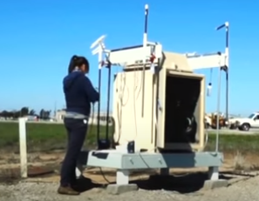
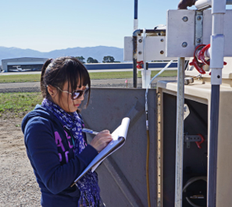
CDPR’s Air Program:
DPR’s Air Program monitors for pesticides in air both in response to reports of pesticides detected in air and as part of its periodic reevaluation of pesticides after registration.
DPR uses a network of stations in the state to monitor weekly for many pesticides in air to ensure that air quality is being protected.
The Air Program develops and evaluates computer models to characterize droplet drift from applications and the emissions from fumigant applications so they can be properly regulated.
This protects adjacent sensitive crops from certain herbicides and helps characterize emissions from new fumigant pesticides so that they can be properly regulated.
The air program also determines the need for, supports development of, and evaluates regulations and permit conditions to protect people from specific pesticides in air.

Slide 4
Sampling Objectives
The primary objective is to monitor MITC (Metam Sodium/Potassium; Dazomet), 1,3-D (Telone), and Chloropicrin in the ambient air during the high-use months of February, March, April, and May.
DPR will collect monitoring data to assess maximum sub-chronic 1,3-D, MITC, and Chloropicrin concentrations in the area.
DPR will compare the measured air concentrations to sub-chronic human health screening levels.
DPR will communicate results to the public through a report and presentations.

Slide 5
Stanislaus County Site Selection
Stanislaus County was selected due to high pesticide use from 2019 – 2021 and high previous rankings on the Air Program’s Site Selection Report
High scores for both fumigant use (Cowan) and environmental justice factors (Cowan, Monterey Park Tract).
Stanislaus County has never had a targeted Seasonal Study by DPR

Slide 6
Pesticides of Interest
Potentially may change
Will sample for 1,3- Dichloropropene (1,3-D), chloropicrin, MITC Pesticides (metam sodium, metam potassium, and dazomet).
Fumigants, Toxic Air Contaminants, and Restricted Materials
Pendimethalin 2%
Chloropicrin* 2%
Potassium Phosphite 2%
Glufosinate- Ammonium
Chlorotha₂l%onil
2%
274 Other A.I.s
15%
1,3-Dichloropropene* 33%
Copper Hydroxide 3%
Sulfur 7%
Glyphosate 10%
Minerial Oil 22%
1,3-D has the highest use in the area.

Slide 7
Pesticides of Interest
Active Ingredient | Acute ppb | Acute Duration | Sub-Chronic ppb |  | Sub-Chronic Duration
MITC | 220 | 8 hours | 1.0 |  | 4 weeks
1,3-D | 55 | 72 hours | 3.0 |  | 13 weeks
Chloropicrin | 73 | 8 hours | 0.35 |  | 13 weeks
DPR’s study duration needs to be at least 13 weeks, so we can compare our average 13- week study concentrations to the sub-chronic ppb values for 1,3-D and chloropicrin.

Slide 8
Potentially may change
Sampling Time Period
120,000
100,000
80,000
Pounds (lbs)
1,3-D MITC
Chloropicrin
60,000
40,000
20,000
0
Jan Feb Mar Apr May Jun Jul Aug Sep Oct Nov Dec
Average of PUR data, 2019 -62021

Slide 9
Sampling Frequency
Potentially may change
DPR will collect four 24-hour samples per week.
Start date will be randomized.
Sampling start date will be Sunday, Monday, or Tuesday.
All samples will be collected at each site.
We will collect QA/QC samples to meet data quality objectives.

Slide 10
Potentially may change
1,3-D Use Maps

Slide 11
Potentially may change
Chloropicrin Use Maps

Slide 12
Potentially may change
MITC Use Maps
10

Slide 13
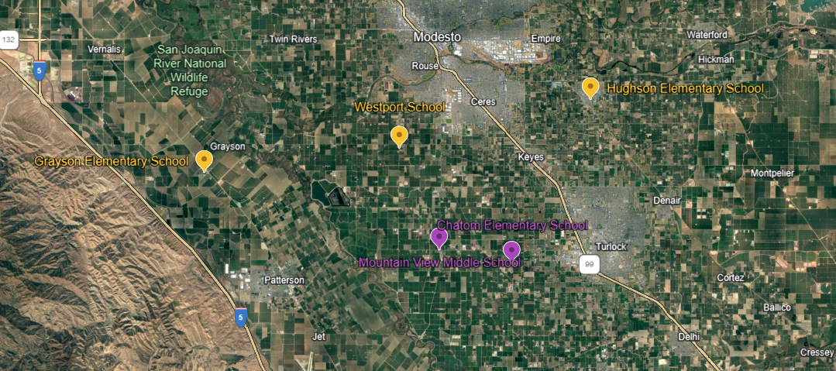
POSSIBLE SCHOOL SITES (PERMISSION AND PARTICIPATION PENDING):
TOP THREE:
Hughson Elementary, Hughson, CA
Grayson Elementary, Westly, CA
Westport Elementary, Modesto, CA
ALTERNATES:
Chatom Elementary, Turlock, CA
Mountain View Middle, Crows Landing, CA

Slide 14
Potentially may change
Site Selection
14

Slide 15
Other Information:
DPR’s Air Program team conducting the study specializes in testing the air to ensure that pesticides do not pose adverse risks to human health and the environment.
The upcoming study is planned to run from February through May 2024.
Suitable locations within Stanislaus County for the study are located near agricultural production areas.
DPR typically chooses school sites for their equipment setup because children are among the most vulnerable populations when it comes to pesticide exposure.
Some key details about DPR’s sampling equipment setup:
Equipment is typically placed in an outdoor area, such as near the blacktops or a parking lot.
DPR requires access to a power source on-site to run their sampling pumps. It's worth noting that the pumps are very small and draw a minimal amount of power
A secure area is essential to prevent tampering with the equipment.
The Air Program team will be on-site five days a week to set up and conduct tests during the specified study period.
DPR is committed to transparency and community involvement. As such, they are willing to provide an overview of our results to interested faculty, staff, and parents at participating schools once we have collected and analyzed all the data.

Slide 16
Questions and Discussion
16

